Slide 1
A Tutorial of Gaussian Mixture Model (GMM)
Nov. 2015
Qiuqiang Kong
q.kong@qmul.ac.uk

Slide 2
Gaussian Distribution
Gaussian Mixture Model (GMM)
A General PGM View of EM algorithm
GMM Revise
Tricks

Slide 3
Gaussian Distribution
The probability density function of Gaussian distribution is
(1)
Gaussian distribution is denominated by parameters:
where
is mean
is covariance
Q: How to estimate the parameters?
A: Using maximum likelihood estimation.
Demonstration of 2-D Gaussian distribution

Slide 4
Applying maximum likelihood estimation method
(2)
where
Is likelihood function
(3)
Optimize (3) with respect to μ, Σ simultaneously is difficult.
However, sample mean is independent of sample variance. So the optimization can be done with respect to μ, Σ separately.

Slide 5
Let the derivative of likelihood L with respect to μ, Σ be zero. We get estimation of μ, Σ.
(4)
Because
is convex function,
The extreme point is global maximum point.
Hint^{[1]}:
is unbiased estimation
is biased estimation, when n-> ∞, it is asymptotic unbiased
[1] Petersen, Kaare Brandt, and Michael Syskind Pedersen. "The matrix cookbook." Technical University of Denmark 7 (2008): 15.

Slide 6
Gaussian Mixture Model (GMM)
Intuitively, GMM is the sum of several weighted Gaussian distributions.
Probability density function of GMM:
(5)
where
Parameters:
Illustration
It is unknown which mixture produce x_{n}.
Define event A_{k}: “the k-th mixture occurs”, k=1, …, K
with probability on A_{k}:
Demostration of GMM, mix number: 3
According to Total Probability Theorem
(6)
which has same form as (5).

Slide 7
GMM parameter estimation using maximum likelihood
(7)
Take constraint
Into account. Introduce Lagrange function
(8)
To optimize R(θ,λ) Let the derivative of R(θ,λ)
with respect to
be zero.

Slide 8
(9)
This is a transcendental equation set, can not be solved analytically.
Solve: introduce iterative method (EM algorithm)
while (not converge)
E step: use old parameters
to calculate
(10)
M step: update
parameters

Slide 9
notice
(11)
EM algorithm
1. Choose initial θold
2. E step: (Expectation)
(12)
where
3. M step: (Maximization)
(13)
4. If converge then stop. Otherwise goto 2.
Q: Will likelihood decrease using EM algorithm?
Q: Will likelihood converge using EM algorithm?

Slide 10
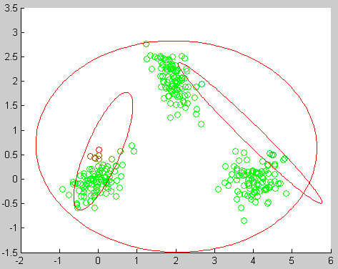
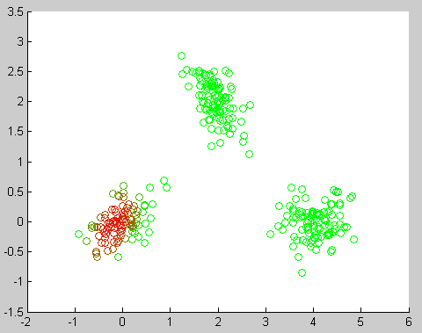
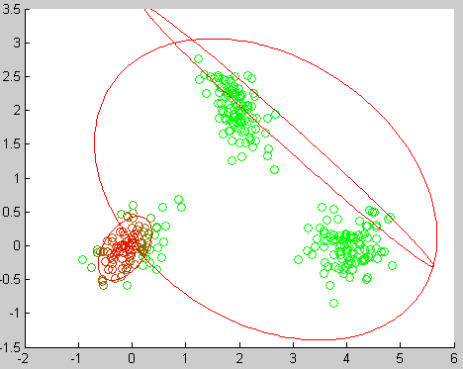
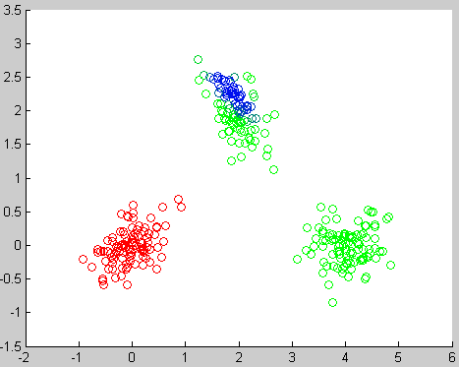
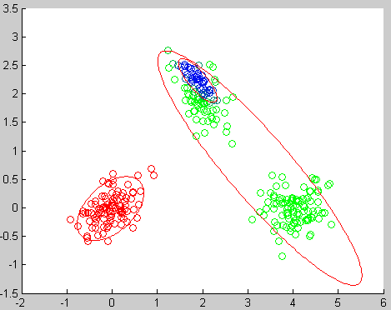
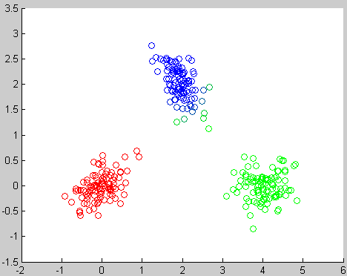
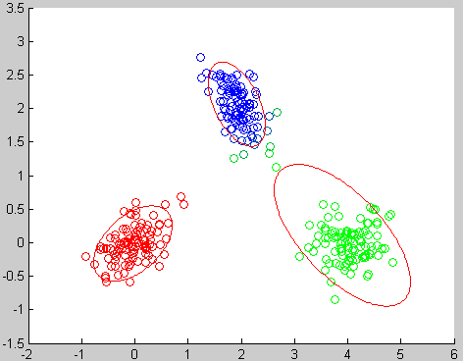


Example of EM algorithm
Initialize parameters
E step
M step
E step
M step
E step
M step
E step
M step

Slide 11
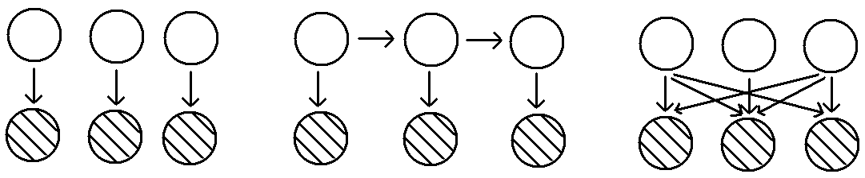
A General View of EM Algorithm
In general, EM algorithm is a method to estimate parameters in a probabilistic graphic model (PGM) with latent variables.
GMM
HMM
Others
Black circle is the observed variable. White circle is latent variable.
The estimation of θ will be
where
Obviously, it is needed to sum all Z before applying log, which is difficult.
EM algorithm is aimed at solving this problem.

Slide 12
Introduce auxiliary function q(Z) over Z
(14)
①
②
② is KL divergence between q(Z) and p(Z|Xθ), which is non negative.
It only equals 0 iff q(Z) and p(Z|Xθ).
E step: Let q(Z) = p(Z|Xθ^{old})
M step: optimize
(15)
with respect to θ
where
(16)

Slide 13
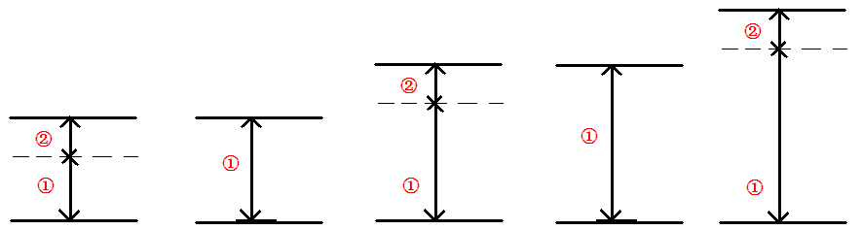
EM algorithm for PGM with latent variables
1. Init parameters
2. E step: q(Z)=p(Z|Xθ^{old})
(17)
3. M step:
(18)
where
4. If converge then stop, otherwise goto 2
Initial paras
E step
M step
E step
M step

Slide 14
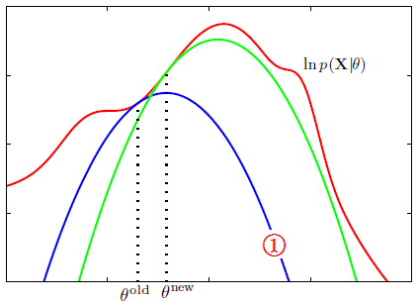
Illustration^{[1]}: For a function which is difficult to find extreme point (red curve), E step is find the complete data function (blue curve), M step is update θ.
Illustration of EM algorithm
Q: Will EM algorithm converge?
A: Under some conditions, EM algorithm will converge to stationary point^{[2]}.
[1] Bishop, Christopher M. Pattern recognition and machine learning. springer, 2006. P453
[2] Wu, CF Jeff. "On the convergence properties of the EM algorithm." The Annals of statistics (1983): 95-103.

Slide 15
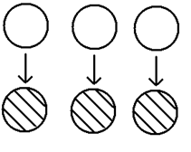
GMM Revise
Define event Ak: “the k-th mixture occurs”, k=1, …, K
with probability on A_{k}:
Let z be K-dimensional binary random variable having 1-of-K representation
GMM
(19)
(the k-th position is 1)
Thinking:
Q: Why choose random variable in this form?
Can we choose others, eg.
z: A_{k} -> k, k=1,…,K?
A: 1-of-K representation belongs to exponential family, which will make computation feasible
The probability over z is
(20)

Slide 16
For GMM model, Q(θ,θ^{old}) is
Independence
of PGM
GMM
(21)
substitute
(22)
into (21), and denote
(23)

Slide 17
We obtain
(24)
Take constraint
into consideration, introduce Lagrange function
(25)
Let the derivative of R(θ,λ) be zero,
we get the estimation of
(26)

Slide 18
EM algorithm for GMM
1. Choose initial θold
2. E step: (Expectation)
where
3. M step: (Maximization)
4. If converge then stop. Otherwise goto 2.
This is the same as previous result.

Slide 19
Tricks
GMM is a non convex problem. There are many local minimum.
Solve: Use kmeans to initialize parameter.
Initialize parameters and run EM algorithm for several times and choose the best model.
Local minimum
Local minimum
2. if eig(Σ) is too small. Then Σ⁻¹ will be unstable.
Solve: if eig(Σ) < ε then Σ = Σ + σI

Slide 20
3. The number of parameters of full GMM is K+K*D+K*D*D. If dataset is small then model will overfit.
Solve: Use diagonal Σ instead. The number of parameters will decrease to K+K*D+K*D.
Full covariance
Diagnoal covariance
4. Gaussian probability density function can be underflow exponentially.
Solve: use log and normalization to solve this problem.

Slide 21
Matlab Code
https://github.com/qiuqiangkong/matlab-gmm

Slide 22
THANK YOU!

